Slide 1
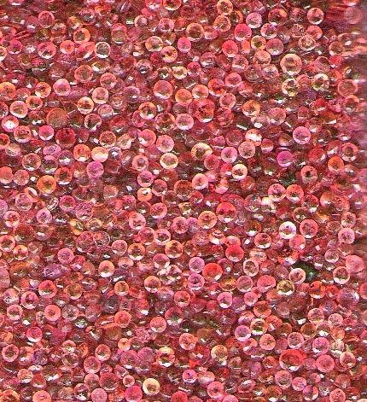
Object-oriented Programming with Ruby
robert batzinger
CSCI A-201
Spring 2009

Slide 2
Lecture 1: Object-oriented design
capturing the essentials of a problem domain as programmable objects

Slide 3
Steps to programming in Ruby
Analyze the problem
Refine the class model to handle implicit information
Implement a class library that models relevant classes of objects
Test the validity of the methods implemented
Provide an interface to initiate the interaction between the classes of objects
Optimize the software

Slide 4
It starts with the analysis of the problem..
Determine the main objects involved
Identify which attributes of the object are key to solving the problem
Identify the simularities between the objects
Identify the relationship between the objects
For example …

Slide 5
Mary: Daddy, can I have another pet?
Dad: You already have a dog, a mouse and a hamster.
Mary: But I want to get a rabbit too!
Dad: Do you realize that how much more work and expense that will be?
Mary: But I will take good care of it!!
Dad: You will have to prove it for me. Also, every new kind of pet requires special ways to be fed and watered. You will have to learn how to care for it properly.
Mary: I will, I will. I’ll figure out it out and give it food and water every day.
Dad: But you get so mixed up with those you do have. Just tonight you gave the cat dog food and put the hamster water bottle in the bird cage.
Mary: I do get forgetful and mixed up sometimes.
Dad: So unless you can take care of the ones you have, I am not buying you another kind of pet.
Mary: Maybe if I could have a program to remind me it would be easier.
Dad: I will talk to my students and see if they could make a tamagotchi to track food and water for each of your pets.

Slide 6
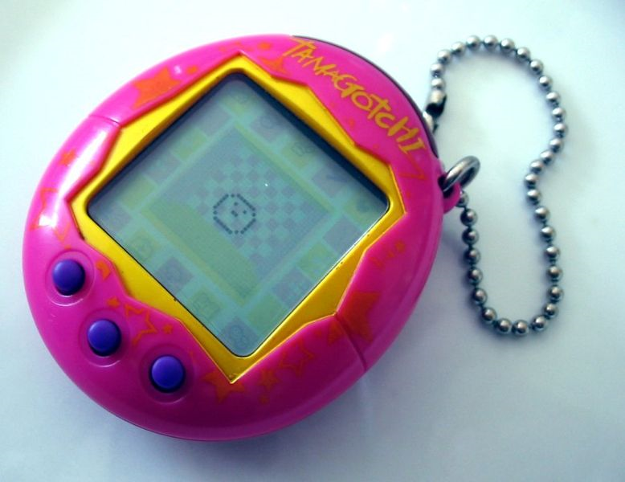
The Tamagotchi (たまごっち)
created in 1996 by Aki Maita and sold by Bandai (over 70 million have been sold)
Three buttons allow the user to select and perform an activity, including:
Feeding it a piece of food or a snack.
Playing games with it.
Cleaning up its waste.
Checking its age, discipline, hunger, happiness and other statistics.
Connecting with other friends
a handheld egg-shaped computer that acts as a digital pet

Slide 7
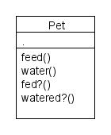
What is the essence of this problem?
Problem statement:
Mary has many pets that she needs to feed and water each day. She needs to be able to verify that she has fed and watered them.
Key components of a model:
For each pet
She must water it daily.
She must feed it daily.
She can check if she watered it
She can check if she fed it.

Slide 8
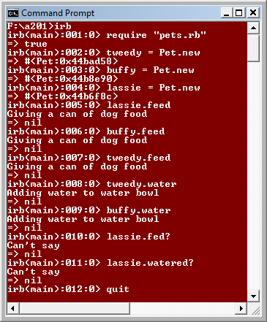
A good start but…
All pets are getting dog food.
The water is being served to all pets in a bowl.
It is not possible to determine which pet got the food or water.
It is not possible to know whether the pet has been fed or watered.

Slide 9
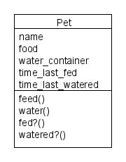
Adding in implicit information
How do we determine the identity of each pet?
What kind of food is needed?
What water container does it use?
How long has it been since the pet was last fed?
How long has it been since the pet was last watered?

Slide 10
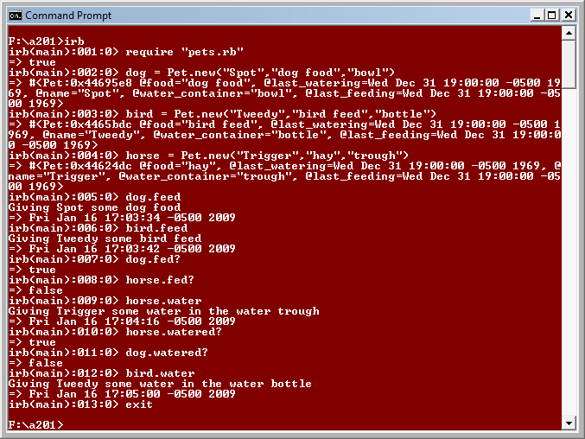
Marked improvement in our model

Slide 11
Comparing to the problem description
We now have all the functionality:
Description | Code equivalent
Add a pet to the system | dog = Pet.new("Spot", "dog food","bowl")
Feed the pet | dog.feed
Water the pet | dog.water
Check if the pet was fed | dog.fed?
Check if the pet was watered | dog.watered?

Slide 12
A class
A class acts a container of attributes and methods we associate with objects of a given type
The attributes list describes characteristics of these objects
Methods List is a toolbox of procedures for changing the attributes
Class ID
Attributes
Methods

Slide 13
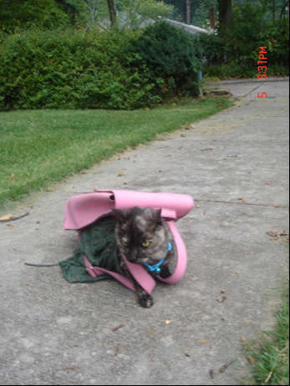
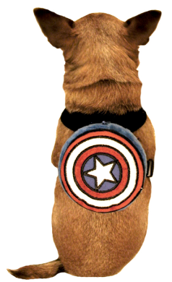
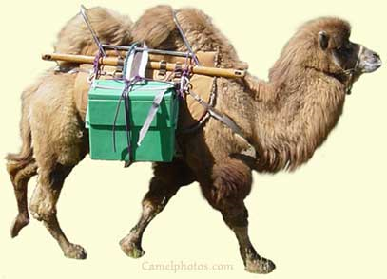
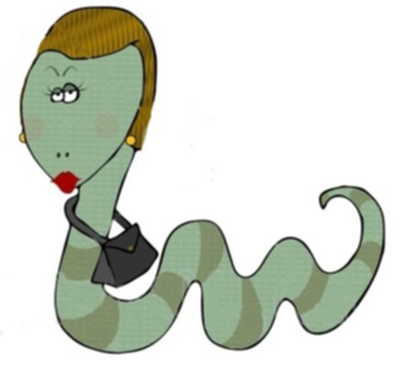
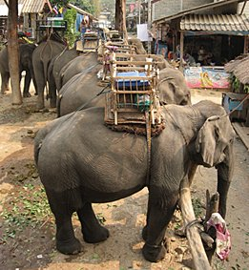
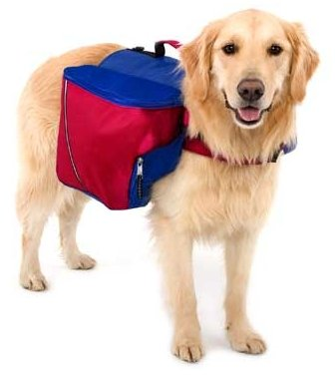
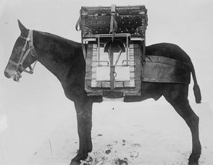
The Pet Class: Animals with customized utility packs

Slide 14
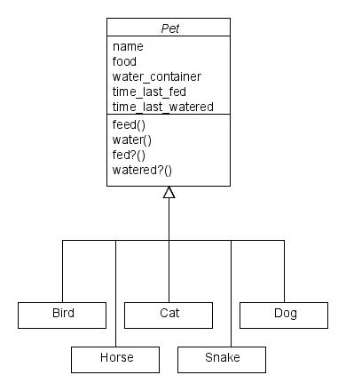
Encapsulation
Using internal processing to simplify the interface.
The subclasses can take care of the details that are constant to them (such as food and water container)

Slide 15
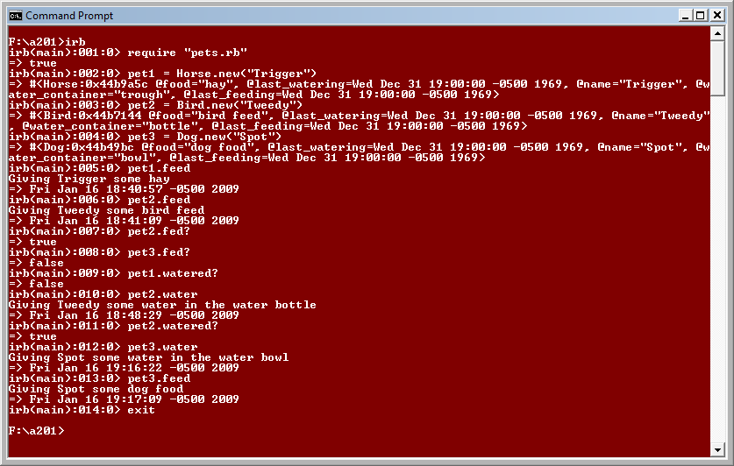
Running interactive Ruby in this mode

Slide 16
The subclasses handle the details
The user still has all the functionality with less work:
Description | Code equivalent
Add a pet to the system | pet1 = Dog.new("Spot“) pet2 = Cat.new(”Buffy”) pet3 = Bird.new(“Tweedy”) pet4 = Horse.new(“Trigger”)
Feed the pet | pet1.feed
Water the pet | pet1.water
Check if the pet was fed | pet1.fed?
Check if the pet was watered | pet1.watered?

Slide 17
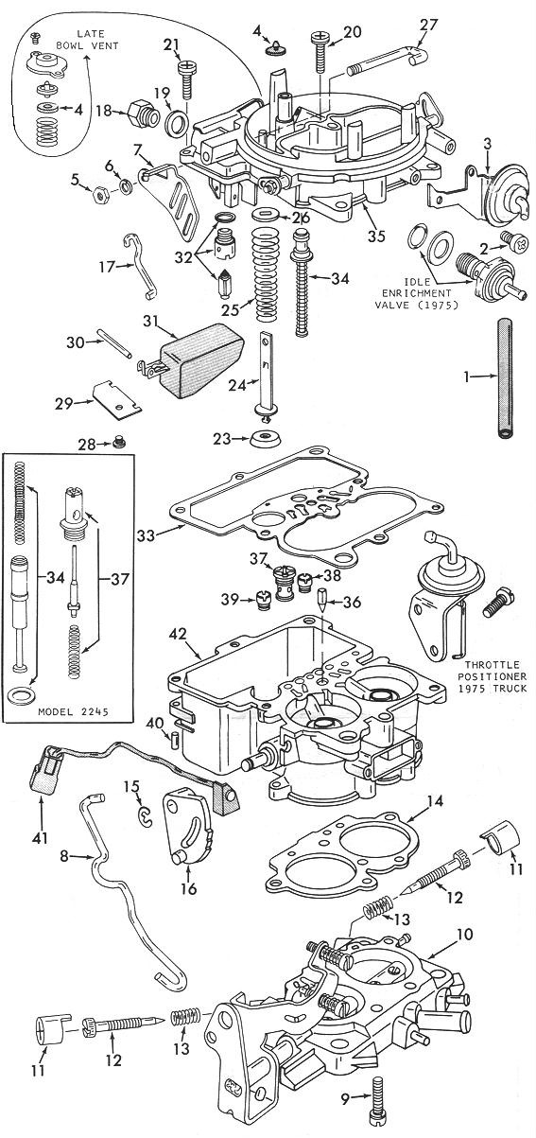
Beware of too much detail
KISS – Keep it simple, Students!
Your model should have enough to solve the relevant issues of the problem
Complete detailed knowledge is not required to solve all problems
Implementation of attributes and methods that will never be used is a waste of time.

Slide 18
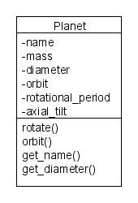
Simple class
Primarily used as a container to keep attributes and methods together
Could be used as a element of an array or other class
The naming scheme is key to its simplicity and clarity
Standardization of the naming scheme is key to the flexibility
Notes:
yty

Slide 19
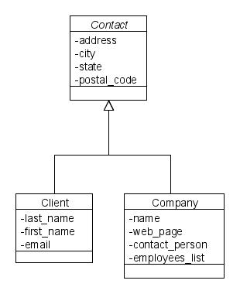
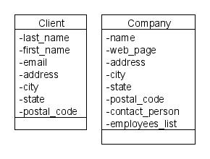
Simplification using inheritance

Slide 20
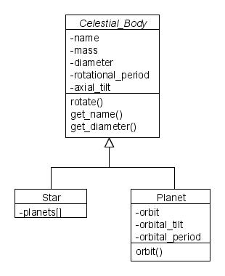
Inheritance
Pool common attributes and methods into a shared container or abstract class
Unique attributes held in separate subclasses

Slide 21
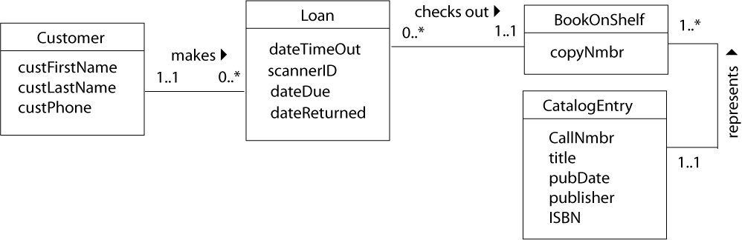
Class Decomposition Diagrams
Shows the interaction between the objects

Slide 22
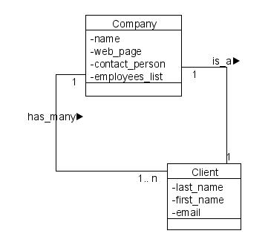
Diagrams required for programming assigns
Class Hierarchy Diagram
Class Decomposition Diagram

Slide 23
What to look for
Classes of Actors: tend to be nouns
Methods: tend to be verbs
Attributes: tend to adjectives and noun phrases

Slide 24
Program description
The weather station must send a data summary of the weather measurements that has been collected from a thermometer, an anemometer, rain gauge and a barometer within the past hour. The weather station sends the hourly summaries of data from its location to its regional weather center. The summary includes minimum, maximum and average temperature and air pressure as well as rainfall and five minute readings of the wind direction and speed.

Slide 25
Main actors identified as Classes
The weather station must send a data summary of the weather measurements that has been collected from a thermometer, an anemometer, rain gauge and a barometer within the past hour. The weather station sends the hourly summaries of data from its location to its regional weather center. The summary includes minimum, maximum and average temperature and air pressure as well as rainfall and five minute readings of the wind direction and speed.

Slide 26
Main actions identified as Methods
The weather station must send a data summary of the weather measurements that has been collected from a thermometer, an anemometer, rain gauge and a barometer within the past hour. The weather station sends the hourly summaries of data from its location to its regional weather center. The summary includes minimum, maximum and average temperature and air pressure as well as rainfall and five minute readings of the wind direction and speed.

Slide 27
Characteristics identified as Attributes
The weather station must send a data summary of the weather measurements that has been collected from a thermometer, an anemometer, rain gauge and a barometer within the past hour. The weather station sends the hourly summaries of data from its location to its regional weather center. The summary includes minimum, maximum and average temperature and air pressure as well as rainfall and five minute readings of the wind direction and speed.

Slide 28
Drawing Classes
ClassName
Attribute 1
Attribute 2
Attribute 3
Class ID
Attribute list
Method list
Method 1 Method 2

Slide 29
Putting the model together
has_many
has_many

Slide 30

Some additional materials
UML basics: An introduction to the Unified Modeling Language http://www.ibm.com/developerworks/rational/library/769.html
UML for Mere Mortals by Robert A. Maksimchuk and Eric J. Naiburg. Published by Addison-Wesley 2005. ISBN 0321246241
Unified Modeling Language (UML) Tutorial
http://atlas.kennesaw.edu/~dbraun/csis4650/A&D/UML_tutorial/

